Slide 1
DATA PRESENTATION
Customer Behavior, Sentiment, and Conversion Analysis in Retail

Slide 2
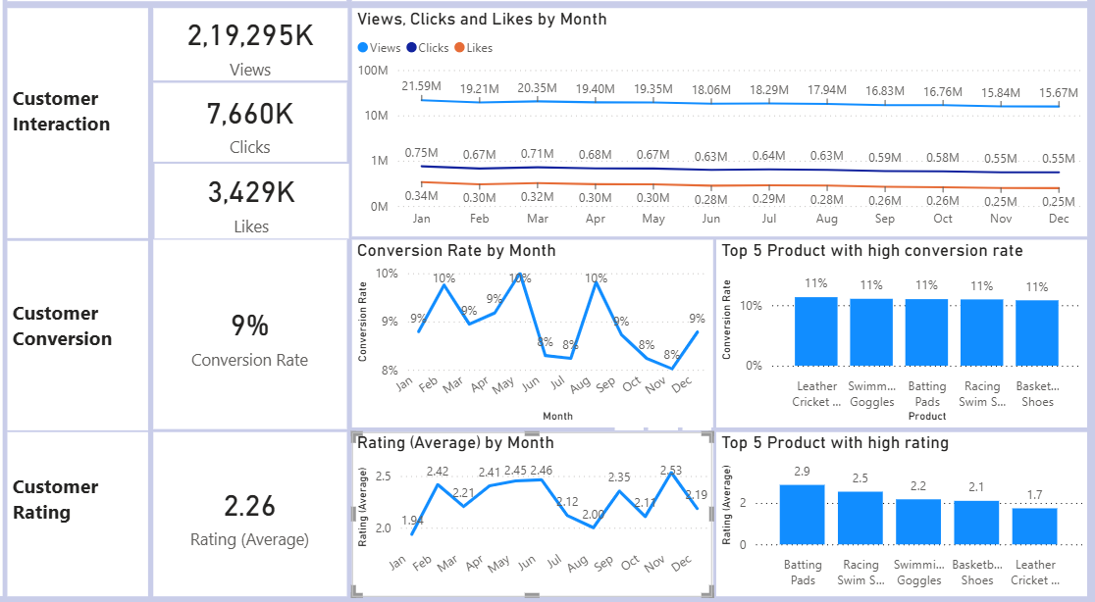
Overview
1. Reduced Customer Engagement:
Views decline gradually from ~21.6M to ~15.6M over a time period.
Clicks drop from ~0.75M to ~0.55M.
Likes decrease from ~0.34M to ~0.25M.
2. Decreased Conversion Rate:
Conversion fluctuates between 8% and 10%.
Peaks seen in March, June, and September (~10%).
Drops observed in July–August and October–November (~8%).
3. Customer Rating Trends:
Average rating: 2.26, which is below acceptable retail benchmark (≥3.5).
Monthly ratings fluctuate but stay mostly between 2.0 – 2.5.
This clearly indicates strong customer reach and engagement, but moderate conversion and low satisfaction levels.

Slide 3
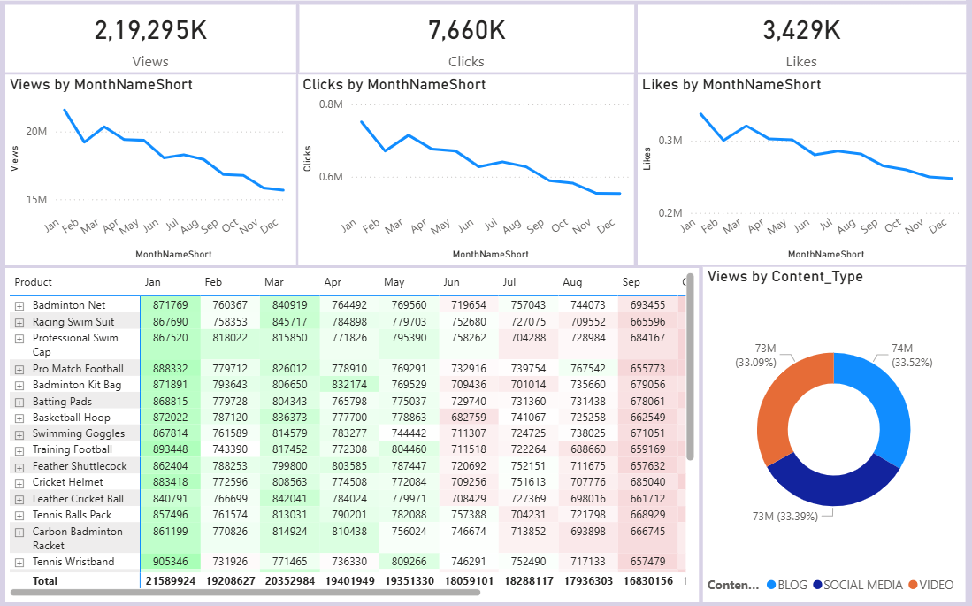
Customer Engagement:
Business has strong digital visibility and customer reach. Marketing campaigns are successfully attracting attention across products. However, engagement alone does not guarantee revenue.
Key Observations:
1. Reduced Customer Engagement:
Engagement peaks in Q1.
Continuous decline through Q2–Q4.
2. Weak Engagement Sustainability:
Big difference in Views to Click and Like ratio.
The company is good at attracting customers initially but struggles to maintain continuous engagement momentum.
3. Product-Level Engagement:
Products like Tennis Wristband, Pro Match Football, Cricket Helmet, Racing Swim Suit show high interactions in January.
Most products experience gradual decline month by month.
No major spikes later in the year → indicates lack of promotional push or innovation.
4. Content Type Performance:
The business is effectively using a multi-channel marketing approach.
The business has strong digital reach, but the declining engagement trend signals future performance risk. To sustain growth, the company must shift from: High traffic generation to Sustained engagement and conversion optimization.

Slide 4
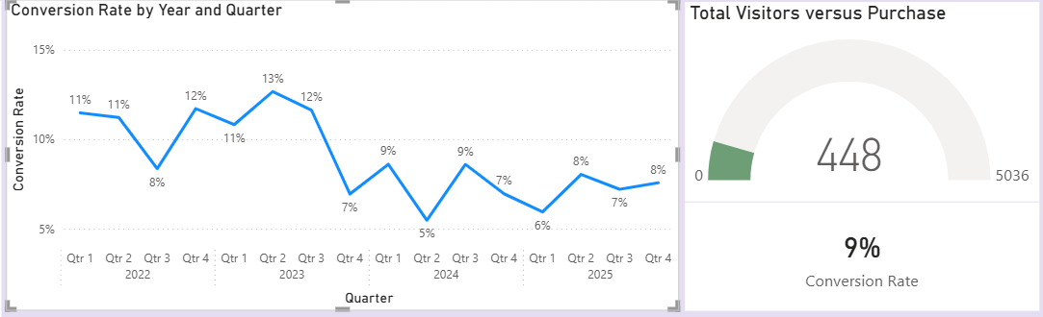
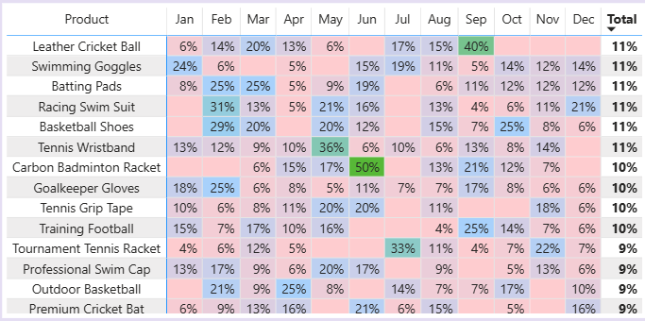
Customer Conversion:
The business is experiencing traffic stability but declining conversion strength. This means marketing is working, but the purchase decision stage is weak.
Key Observations:
1. Downward trend in Conversion:
There is a downward trend in conversion efficiency from 2023 to 2024, with only partial recovery in 2025.
2. Very low Conversion Rate:
Out of 5036 visitors only 448 are become paying customers.
Conversion rate is only 9% that means nearly 90% visitors do not complete a purchase.
3. Overdependence on Few Products:
Revenue likely concentrated in 5–6 high performers.
Some products show very high spikes in certain months and very low conversion in others. This indicates unstable demand cycles. If seasonal spikes fail, overall performance drops.
4. Inconsistent Monthly Strategy:
No uniform campaign support throughout the year.
The company is facing a declining quarterly conversion rate trend, especially after 2023, indicating inefficiencies in turning visitors into paying customers, leading to significant revenue leakage despite strong customer traffic.

Slide 5
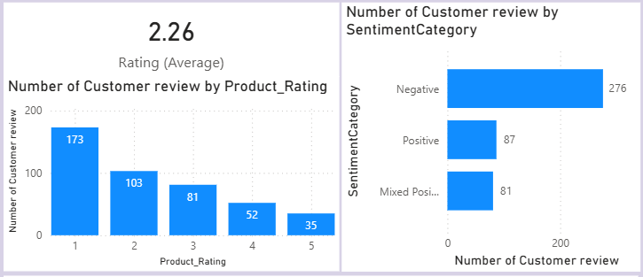
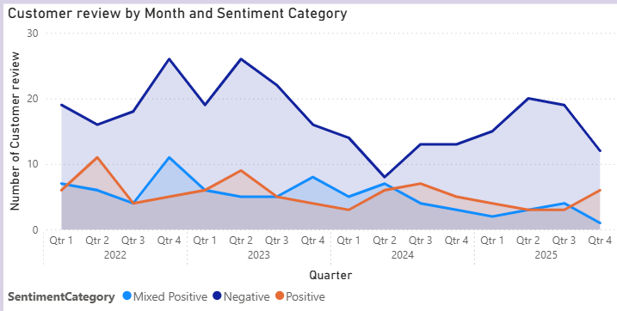
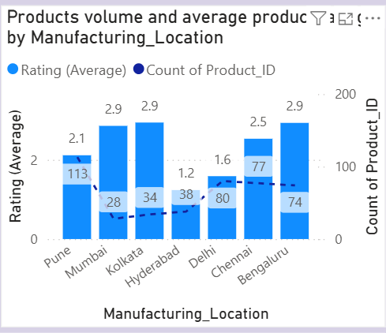
Customer Feedback:
The company is facing widespread product dissatisfaction, Quality inconsistency across manufacturing locations and Persistent negative customer sentiment over multiple years.
Key Observations:
1. Low Customer Satisfaction:
Average rating is 2.26. This is significantly below the acceptable retail benchmark.
This shows customers are generally dissatisfied with the products or overall experience.
2. Negative Customer Perception Trend:
Majority of reviews are 1 and 2 and very few 4 and 5 ratings.
The rating pyramid is inverted — instead of strong satisfaction at the top, dissatisfaction dominates.
3. Feedbacks are dominated by Negative sentiment:
Negative reviews are more than double positive ones. This strongly explains the declining conversion trend observed earlier.
Peak negative periods seen in Q4 of 2022 & Q2 of 2023. 2024 shows some reduction, but still dominant and 2025 shows mild improvement but not substantial. It indicates business has not effectively resolved customer complaints across years.
4. Quality inconsistency across manufacturing units:
Hyderabad and Delhi show extremely low ratings and Mumbai, Kolkata, and Bengaluru perform relatively better.
Quality inconsistency across manufacturing units is likely affecting product quality and it leads to the customer dissatisfaction.
Core structural weakness of the business is not lack of traffic — it is poor customer satisfaction and negative perception. Unless product quality and experience improve conversion will remain unstable, Marketing costs will increase and Brand equity will decline.

Slide 6
Recommendations:
1. Improve Product Quality:
Conduct strict quality audits across all manufacturing units.
Redesign or upgrade low-rated products.
Standardize quality control procedures.
2. Enhance Customer Experience:
Simplify checkout and payment process.
Strengthen after-sales support.
3. Increase Conversion Rate:
Add customer reviews and ratings on product pages.
Offer limited-time discounts and combo offers.
Use remarketing campaigns for abandoned carts.
Provide first-time buyer incentives.
4. Optimize Product Portfolio:
Focus marketing budget on high-converting products.
Bundle low-performing products with best sellers.
Discontinue consistently weak-performing SKUs
5. Seasonal Marketing Strategy:
Plan campaigns around sports seasons and festivals.
Launch targeted promotions during low-performing months.
Introduce limited edition or seasonal collections.
6. Strengthen Customer Retention:
Introduce loyalty programs.
Offer repeat purchase discounts.
Personalize product recommendations.
7. Improve Brand Reputation:
Respond to negative reviews professionally.
Encourage satisfied customers to leave feedback.
Monitor sentiment trends regularly.

